Slide 1

Agor.ai
A reliable teaching assistant and tutor for the future
Lesley Lu, Xinyu Zhang, Hans Junoes

Slide 2
Table of contents
01
02
03
Motivation
Solution
Implementation

Slide 3
01
Put your hand up if you’ve been too scared to ask a question in class.

Slide 4
90%
>50%
60 hours
Of teachers were HIGHLY stressed
Working OVER
a week
Source: Hong Kong Federation of Education Workers 2024

Slide 5
90%
>50%
60 hours
Students can’t get
the help they need
Of teachers were HIGHLY stressed
Working OVER
a week

Slide 6

Our traditional teaching methods are no longer enough to meet the diverse and changing needs of the classroom.

Slide 7

We need to make learning personal, engaging, and accessible—where every student can feel supported

Slide 8
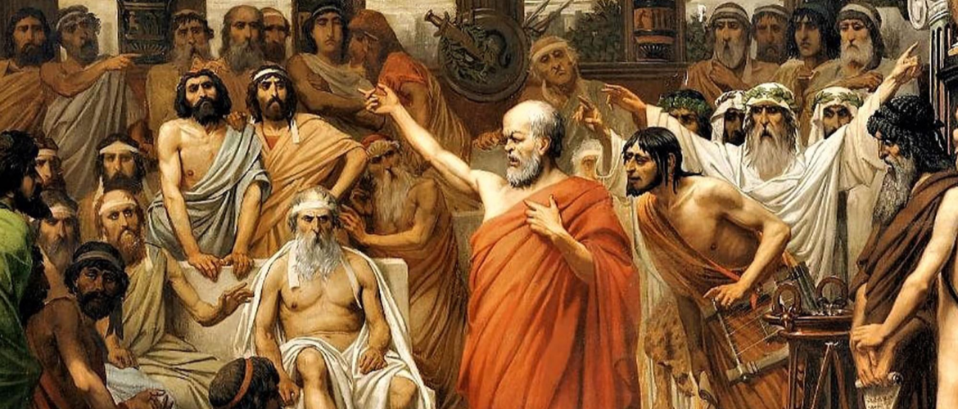
A tutor who didn’t just provide answers but engaged them in a dialogue to uncover solutions together—just like Socrates?

Slide 9
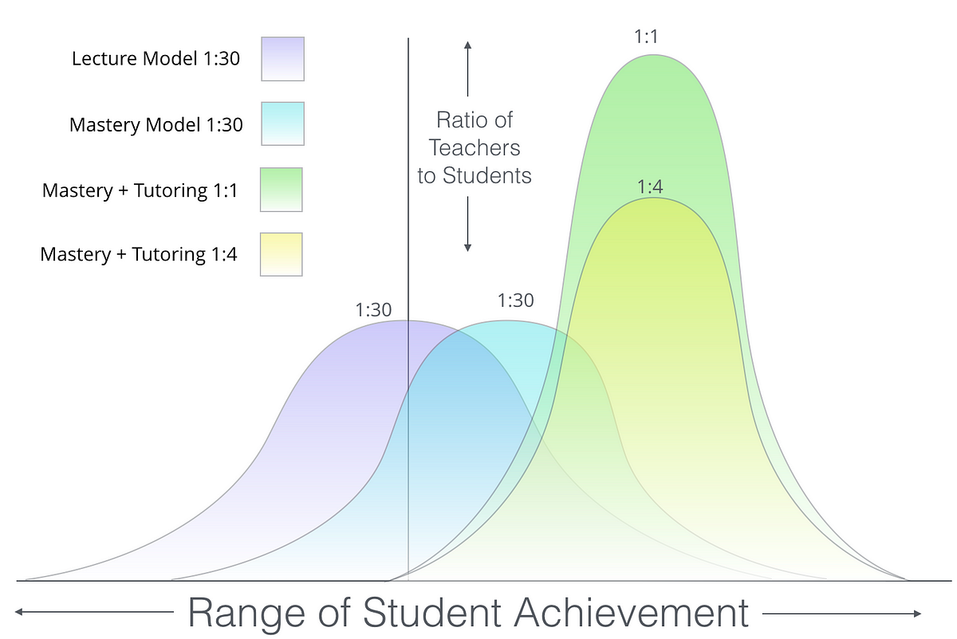
2 Sigma Problem
98%
Average tutored student above
of students taught in traditional classrooms.
A distribution graph reconstructed from Bloom’s 1984 2-Sigma research : Source

Slide 10
2 Sigma Problem
98%
80%
Average tutored student above
of students taught in traditional classrooms.
Almost all tutored students
Outperformed 80% of the classroom students
A distribution graph reconstructed from Bloom’s 1984 2-Sigma research : Source

Slide 11
Personalized, one-on-one teaching can be transformative – but providing it to every student has always been impossible.

Slide 12

Agor.ai

Slide 13



Always Available
Adapts to individual student needs
Supports teachers

Slide 14
02
Our Proposed Solution

Slide 15


Our Proposed Solution
Teacher Dashboard
Realistic Avatar
Tutor

Slide 16

Virtual Tutor Avatar
a conversational and auditory experience
1. Natural spoken dialogue:
Mimicking interactions with a real tutor
2. Retrieval-Augmented Generation:
Strictly follows provided content, avoiding misinformation

Slide 17
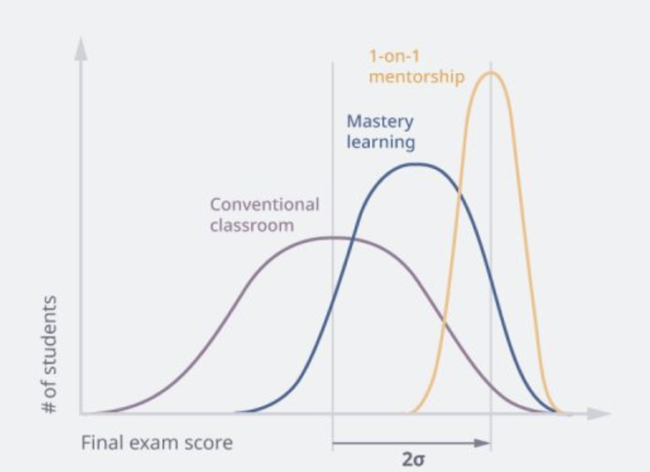
Virtual Tutor Avatar
a conversational and auditory experience
3. Socratic teaching method: ¹
Guiding students with questions
4. Ask questions mid-conversation:
Interactive learning process
5. Supported by Bloom’s 2 sigma phenomenon
^{Figure produced by Lecturio}
¹ Kruse, S. (2023, February 23). The socratic method: fostering critical thinking. The Institute for Learning and Teaching.

Slide 18
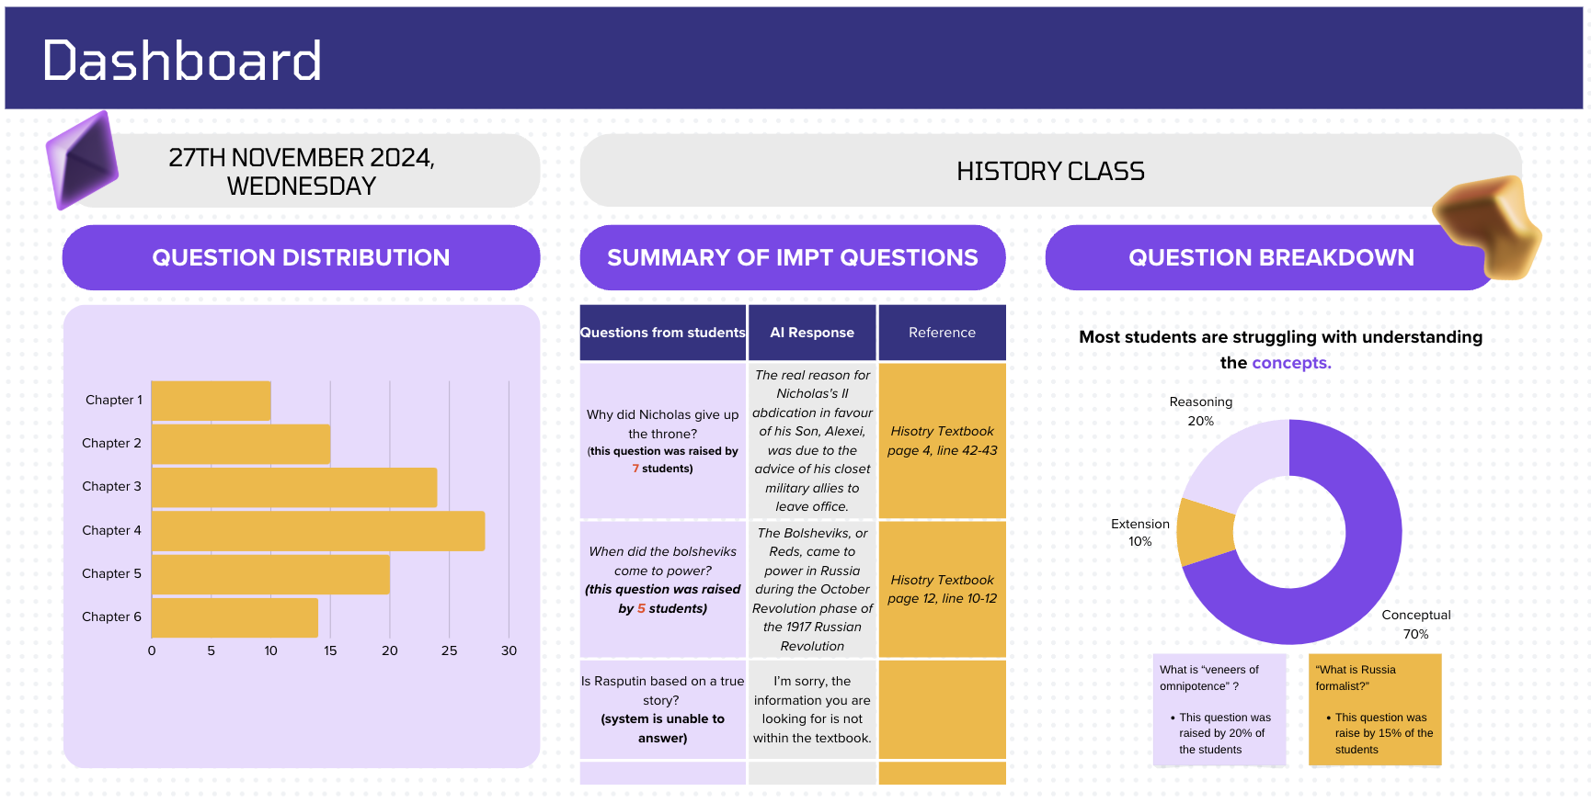

Slide 19
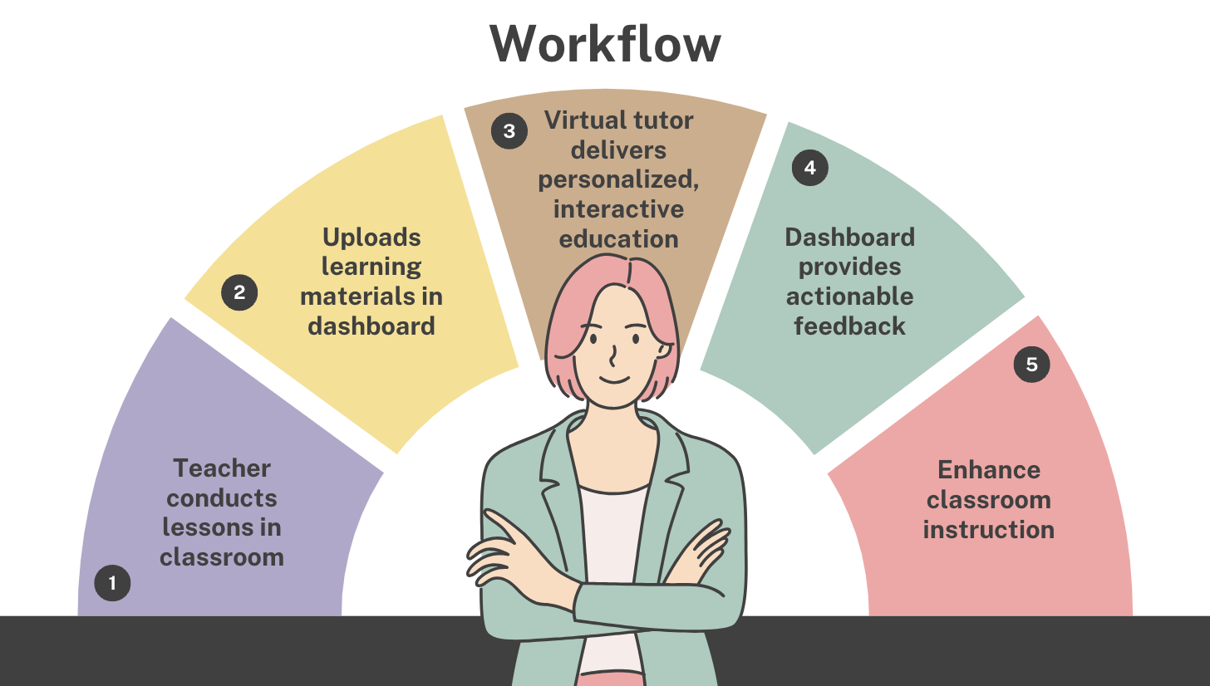

Slide 20
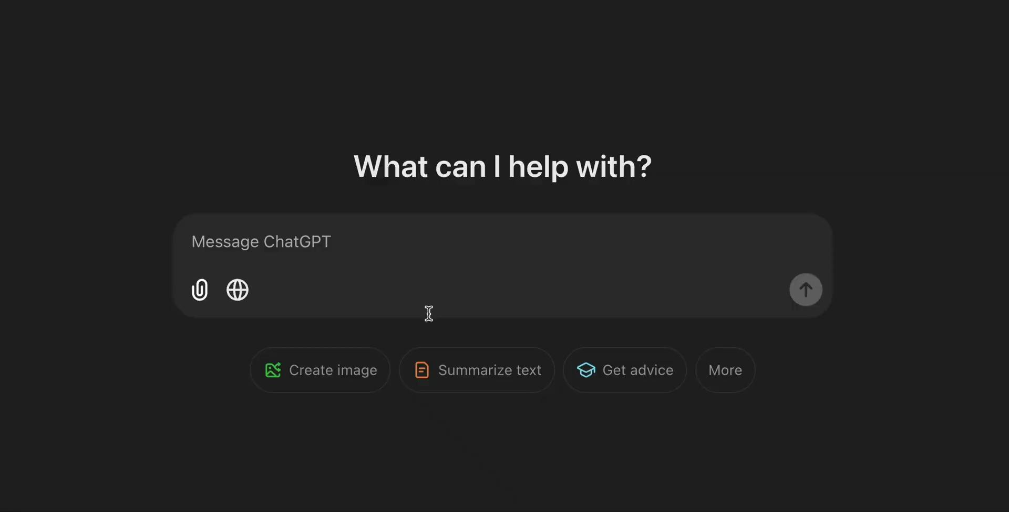
DEMO Comparison
https://drive.google.com/file/d/1teefSrIyGDty1DWcCVOAFUy13LHdd0uv/view?usp=sharing

Slide 21

DEMO Comparison
https://drive.google.com/file/d/1FZdVpt7Oj9iXWENzD_fkP_YFsR7h8dYa/view?usp=sharing

Slide 22
03
Our Roadmap to Success

Slide 23
Strategic Roadmap
Design
Pilot
Launch
User Requirements
In a Real Setting
The Final Product
Build
Network
An Early Prototype
Stay up to-date

Slide 24

Design
A personalised conversational experience
1. Target Consumers:
Educational institutions
2. Target Users:
Secondary to highschool students

Slide 25

Build
Early design and functionalities
1. Personalised:
AI Avatars and personalities
2. Contextualised:
Faithful to the source of information

Slide 26

Pilot
Implement in a real environment
1. Monitor:
Guide testers in real-time
2. Analyze:
User data and feedback
3. Refine
Features and functionalities

Slide 27

Network
Meet future partners and industry professionals
1. Build relationships:
Exchange information and stay
up-to-date
2. Upgrade:
State-of-the-art technology
3. Open opportunities
More environments, more data

Slide 28
Launch
Launch
Metrics
Business
Model
Future Expansions
- Integration in curriculums of 2 or more small to medium sized institutions
- Inaccuracy rate of < 2%
Subscription-based platform for educational institutions teaching children of ages 12-18 in heavy-content subjects
- Larger institutions
- More subjects
- Higher education

Slide 29
Q & A

